Slide 1
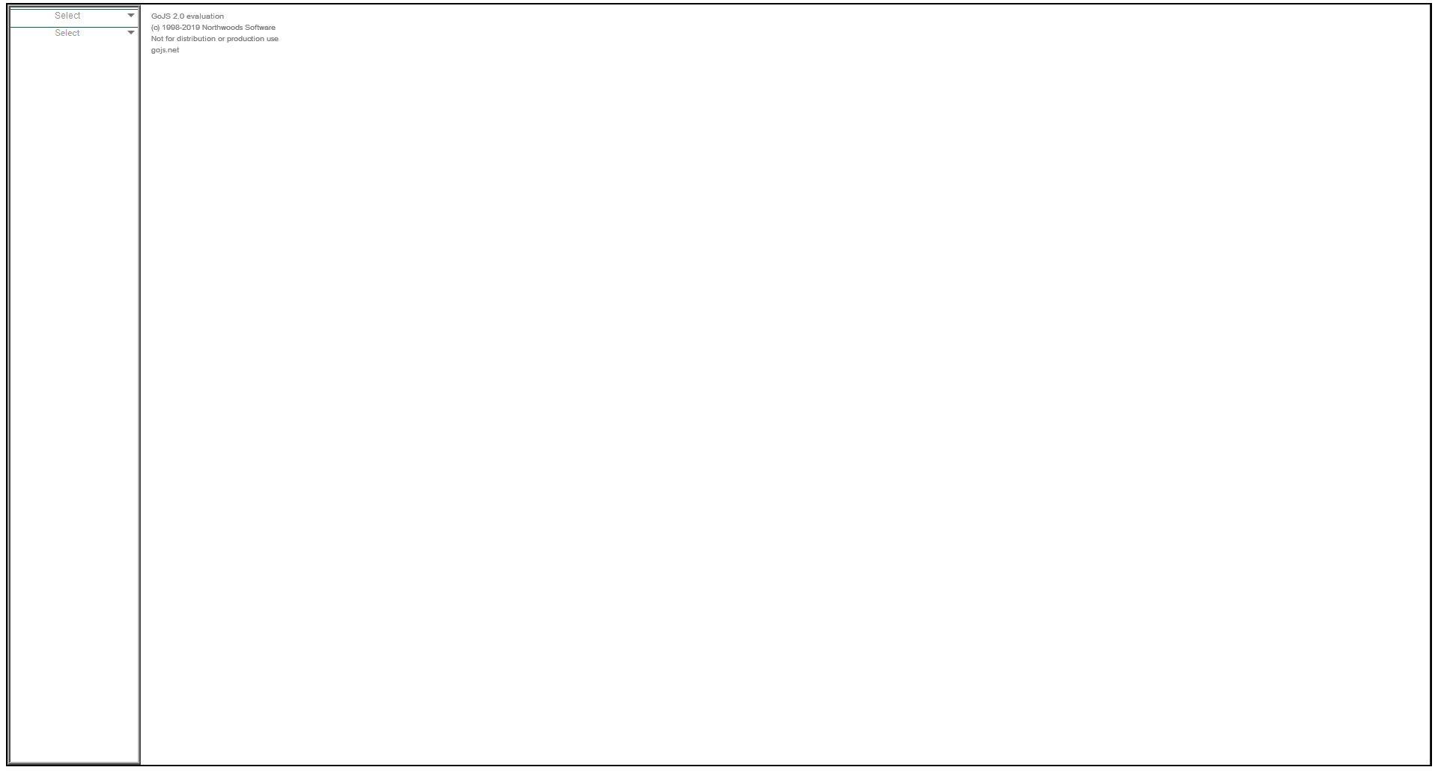


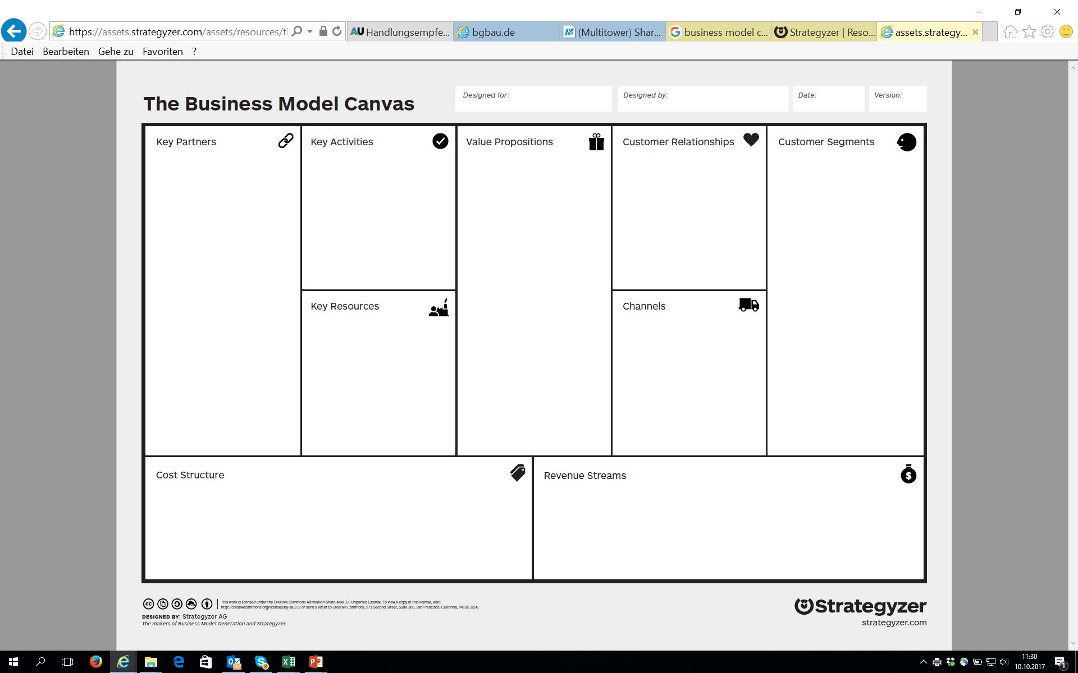

Business Model Design
Business Model Canvas
Cost Structure
Fixed Costs
Variable Costs
Salaries
Notes:
Panel-example

Slide 2
Designed for
Notes:
BMC-name, date, creator

Slide 3
Designed for
Notes:
BMC-name, date, creator

Slide 4
Designed by
Notes:
BMC-name, date, creator

Slide 5
Designed by
Notes:
BMC-name, date, creator

Slide 6
Date of creation
Notes:
BMC-name, date, creator

Slide 7
Date of creation
Notes:
BMC-name, date, creator

Slide 8

Notes:
Offering

Slide 9

Micro Market
Notes:
Customer Segments

Slide 10
Micro Market
Notes:
Customer Segments

Slide 11
Niche Market
Notes:
Customer Segments

Slide 12
Niche Market
Notes:
Customer Segments

Slide 13
Mass Market
Notes:
Customer Segments

Slide 14
Mass Market
Notes:
Customer Segments

Slide 15
Segmented Market
Notes:
Customer Segments

Slide 16
Segmented Market
Notes:
Customer Segments

Slide 17
Notes:
Customer Segments

Slide 18

Notes:
Customer Relationships

Slide 19

Notes:
Channels

Slide 20

Notes:
Key Partnerships

Slide 21

Notes:
Key Activities

Slide 22

Notes:
Key Ressources

Slide 23

Notes:
Revenue Streams

Slide 24

Notes:
Cost Structure – fixed Costs

Slide 25
Notes:
Cost Structure – Variable Costs

